Slide 1
2
CHAPTER
FUNDAMENTAL
DATA TYPES

Slide 2
Chapter Goals
To understand the properties and limitations of integers and floating-point numbers
To be able to declare and initialize variables and constants
To write arithmetic expressions and assignment statements
To create programs that read and process inputs, and display the results
To learn how to use the Java String type

Slide 3

Contents
Declaring Variables
Variable Assignment
Reading Input
Constants
Arithmetic
Strings
Numbers and character strings (such as the ones in this
display board) are important data types in any Java
program. In this chapter, you will learn how to work with
numbers and text, and how to write simple programs that
perform useful tasks with them.

Slide 4
2.1 Declaring Variables
Most computer programs hold temporary values in named storage locations
Programmers name them for easy access
There are many different types (sizes) of storage to hold different things
You ‘declare’ a variable by telling the compiler:
What type (size) of variable you need
What name you will use to refer to it

Slide 5

An Example: Soda Deal
Soft drinks are sold in cans and bottles. A store offers a six-pack of 12-ounce cans for the same price as a two-liter bottle. Which should you buy? (12 fluid ounces equal approximately 0.355 liters.)
List of variables: Type of Number
Number of cans per pack Whole number
Ounces per can Whole number
Ounces per bottle Number with fraction

Slide 6
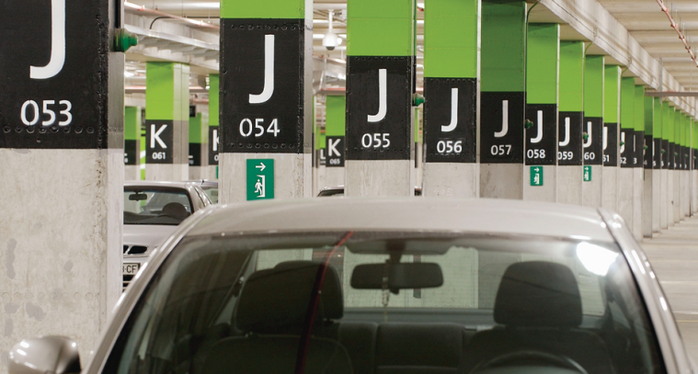
Variables and contents
Each variable has an identifier (name) and contents
You can (optionally) set the contents of a variable when you declare it
int cansPerPack = 6;
Imagine a parking space in a parking garage
Identifier: J053
Contents: Bob’s Chevy
cansPerPack
6
A variable is a storage location with a name

Slide 7
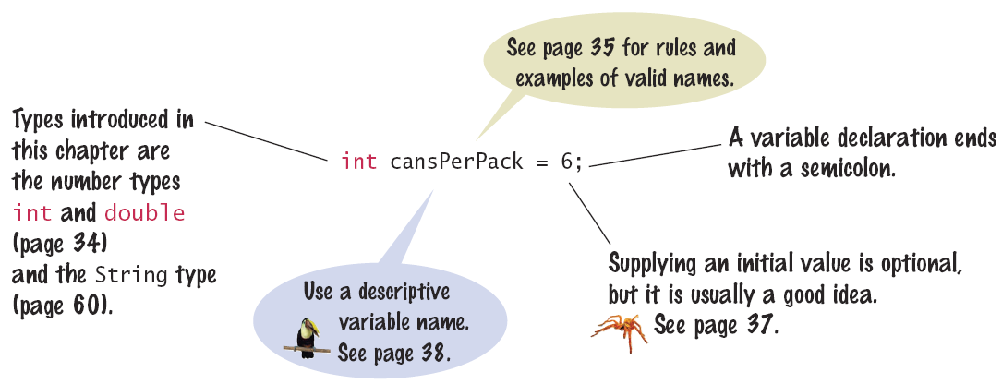
Syntax 2.1: Variable Declaration
When declaring a variable, you often specify an initial value
This is also where you tell the compiler the size (type) it will hold

Slide 8
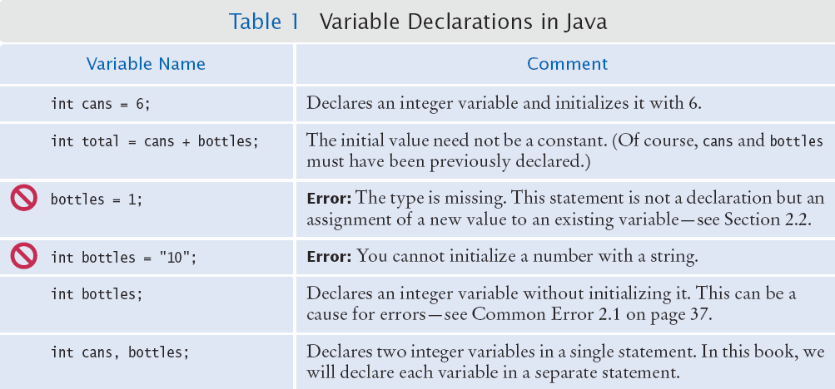
Example Declarations

Slide 9


Why different types?
There are three different types of variables that we will use in this chapter:
1) A whole number (no fractional part) int
2) A number with a fraction part double
3) A word (a group of characters) String
Specify the type before the name in the declaration
int cansPerPack = 6;
double canVolume = 12.0;
Back to the garage analogy, parking spaces may be different sizes for different types of vehicles
Bicycle
Motorcycle
Full Size
Electric Vehicle

Slide 10
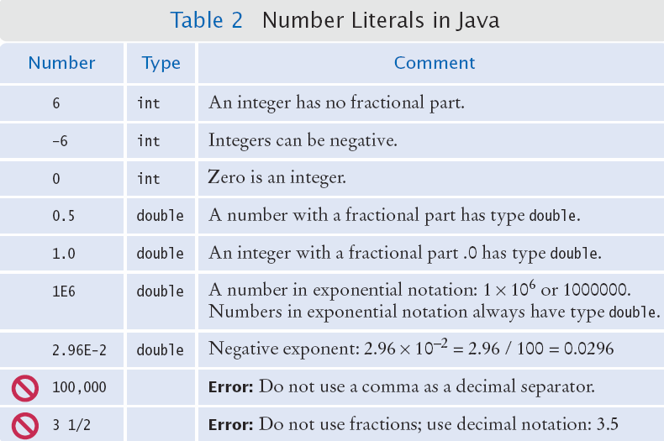
Number Literals in Java
Sometimes when you just type a number, the compiler has to ‘guess’ what type it is
amt = 6 * 12.0;
PI = 3.14;
canVol = 0.335;
Use the double
type for floating-
point numbers.

Slide 11
Floating Point Numbers
Java stores numbers with fractional parts as ‘floating point’ numbers.
They are stored in four parts
Sign
Mantissa
Radix
Exponent
A ‘double’ is a double-precision floating point number: It takes twice the storage (52 bit mantissa) as the smaller ‘float’ (23 bit mantissa)
Parts of a floating point number -5:
Sign | Mantissa | Radix ^{exponent}
-1 | 5 | 10 ⁰

Slide 12

Naming Variables
Name should describe the purpose
‘canVolume’ is better than ‘cv’
Use Five Simple Rules
1) Use only letters, digits or the underscore ( _ )
Don’t start with a digit
2) Separate words with ‘camelHump’ notation
3) Variable names are case-sensitive
4) Don’t use reserved ‘Java’ words
5) Variables start with lower case, class names with upper case (by convention, not a ‘rule’)

Slide 13
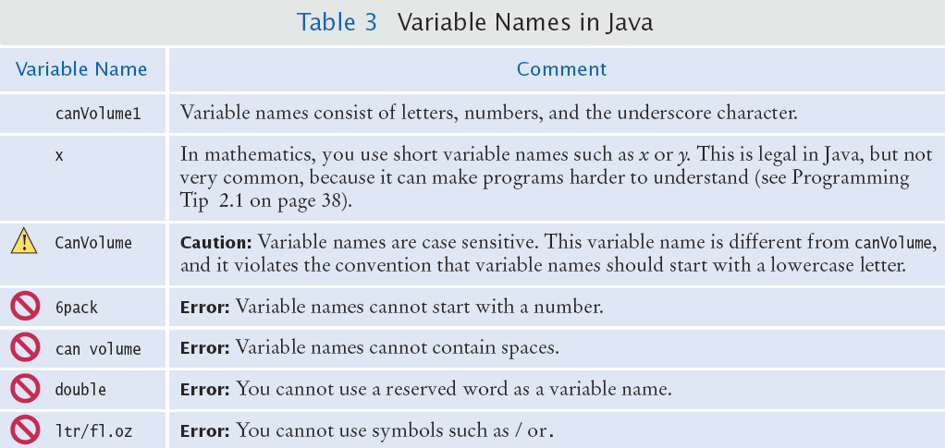
Variable Names in Java
Legal and illegal variable names

Slide 14
Java Comments
There are three forms of comments:
1: // single line (or rest of line to right)
2: /*
multi-line – all comment until matching
*/
3: /**
multi-line Javadoc comments
*/
Use comments at the beginning of each program, and to clarify details of the code
Use comments to
add explanations for
humans who read
your code. The
compiler ignores
comments.

Slide 15
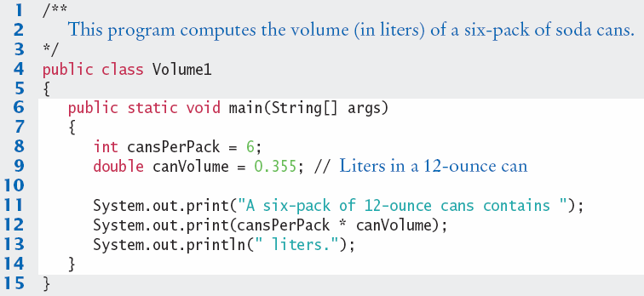
Java Comment Example
Lines 1-3 are Javadoc comments for the class ‘Volume1’
Line 9 uses a single-line comment to clarify the unit of measurement

Slide 16

Common Error 2.1
Undeclared Variables
You must declare a variable before you use it: (i.e. above in the code)
double canVolume = 12 * literPerOunce; // ??
double literPerOunce = 0.0296;
Uninitialized Variables
You must initialize (i.e. set) a variable’s contents before you use it
int bottles;
int bottleVolume = bottles * 2; // ??

Slide 17
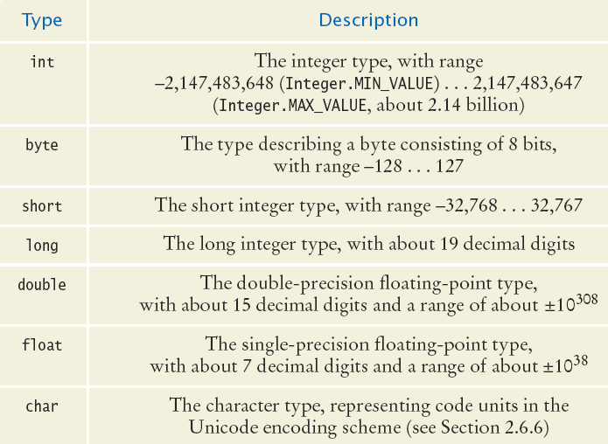
All of the Java Numeric Types
Whole Numbers (no fractions)
Floating point Numbers
Characters
(no math)
Each type has a range of values that it can hold

Slide 18
Value Ranges per Type
Integer Types
byte: A very small number (-127 to +128)
short: A small number (-32768 to +32767)
int: A large number (-2,147,483,648 to +2,147,483,647)
long: A huge number
Floating Point Types
float: A huge number with decimal places
double: Much more precise, for heavy math
Other Types
boolean: true or false
char: One symbol in single quotes ‘a’

Slide 19
Storage per Type (in bytes)
Integer Types
byte:
short:
int:
long:
Floating Point Types
float:
double:
Other Types
boolean:
char:

Slide 20
Common Error 2.2
Overflow means that storage for a variable cannot hold the result
int oneThousand = 1000; // no problem
int oneMillion = 1000 * oneThousand; // OK
int oneBillion = 1000 * oneMillion; // OK
System.out.println(3 * oneBillion); // ??
Will print out -1294976296
Why?
The result (3 billion) overflowed int capacity
Maximum value for an int is +2,147,483,647
Use a long instead of an int (or a double)

Slide 21
2.2 Variable Assignment
You can use the ‘assignment operator’ ( = ) to place a new value into a variable
int cansPerPack = 6; // declare & initialize
cansPerPack = 8; // assignment
Beware: The = sign is NOT used for comparison:
It copies the value on the right side into the variable on the left side
You will learn about the comparison operator in the next chapter

Slide 22
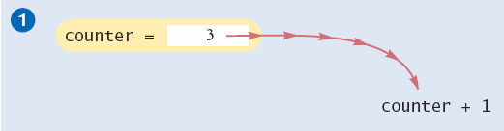
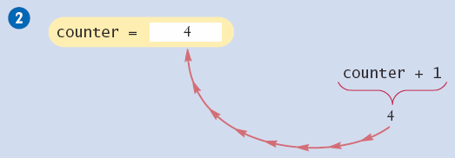
Incrementing a Variable
Step by Step:
counter = counter + 1;
Do the right hand side of the assignment first:
Find the value stored in counter, and add 1 to it
Store the result in the variable named on the left side of the assignment operator (counter in this case)

Slide 23
Shorthand for Incrementing
Incrementing (+1) and decrementing (-1) integer types is so common that there are shorthand version for each
Long Way | Shortcut
counter = counter + 1; | counter++ ;
counter = counter - 1; | counter-- ;

Slide 24
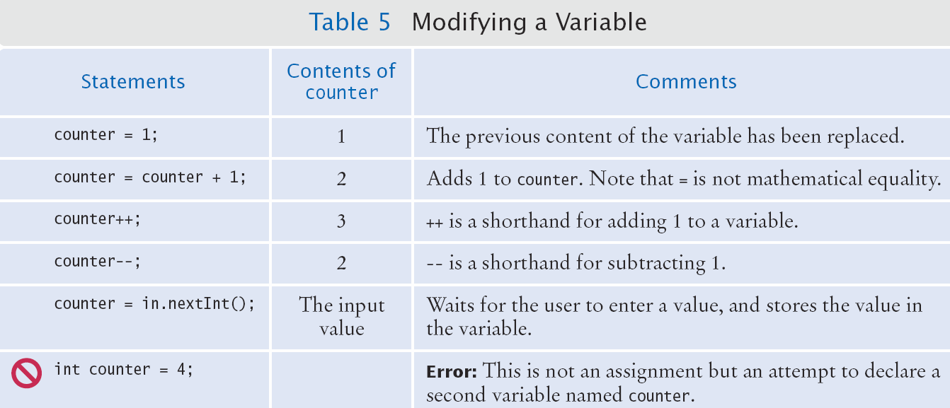
Modifying a Variable
Assumes counter has already been declared:
int counter;

Slide 25
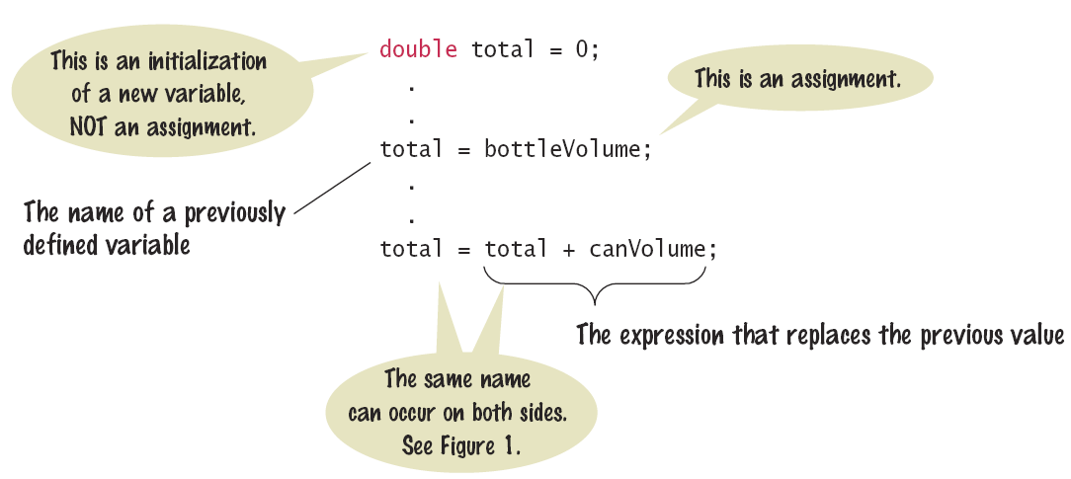
Syntax 2.2: Assignment
The details of the assignment statement
The value on the right is copied to the variable on the left

Slide 26
2.3 Reading Input
You might need to ask for input (aka prompt for input) and then save what was entered.
We will be reading input from the keyboard
For now, don’t worry about the details
This is a three step process in Java
Import the Scanner class from its ‘package’ java.util
import java.util.Scanner;
Setup an object of the Scanner class
Scanner in = new Scanner(System.in);
Use methods of the new Scanner object to get input
int bottles = in.nextInt();
double price = in.nextDouble();

Slide 27
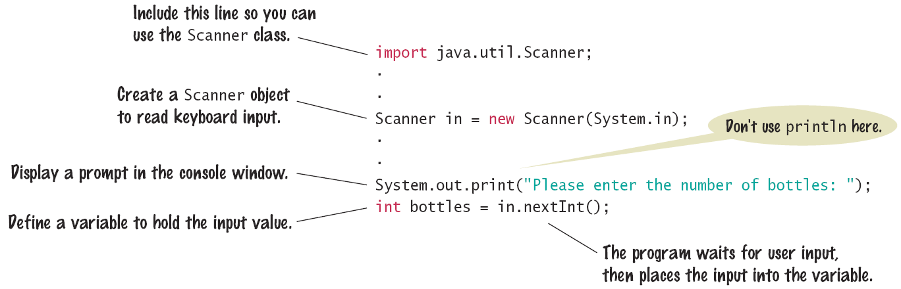
Syntax 2.3: Input Statement
The Scanner class allows you to read keyboard input from the user
It is part of the Java API util package
Java classes are grouped into packages. Use the import statement to use classes from packages.

Slide 28
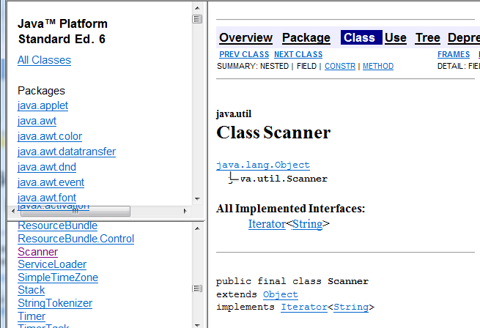
Tip 2.2 Java API Documentation
Lists the classes and methods of the Java API
On the web at: http://java.sun.com/javase/6/docs/api/
Packages
Methods
Classes

Slide 29
2.4 Constants
It is good practice to declare values that do not change as ‘constants’
Use the reserved word final before the type
final double BOTTLE_VOLUME = 1.75;
Then use the constant name instead of the value:
They can be used by name just like variables
double volume = bottles * BOTTLE_VOLUME;
Constants are usually declared near the beginning of a program or a class
If you edit the constant value and re-compile, and the rest of the code will use the new value!
You cannot assign a new value to a constant at run-time.

Slide 30
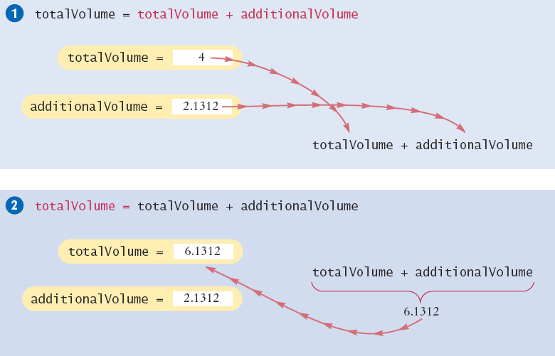
Keeping a running total (1)
Declare a ‘total’ variable to store the running total
Initialize it to 0 or a starting value
Add to the total as you go as shown:
Note that totalVolume is on both sides of the assignment statement

Slide 31
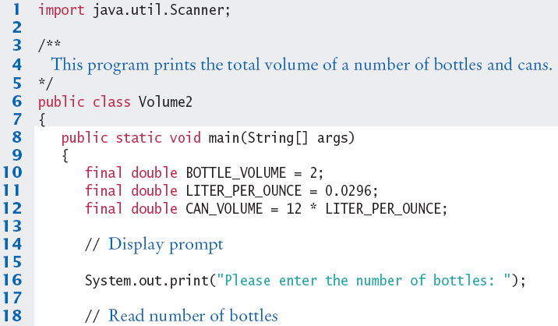
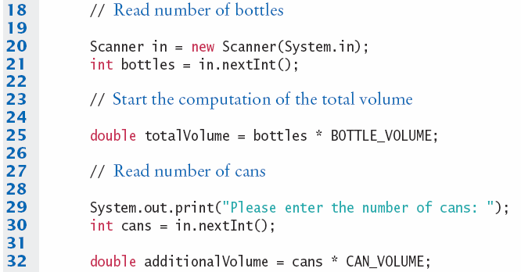
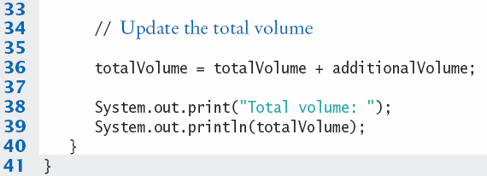
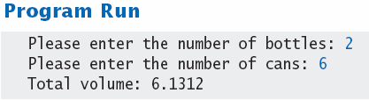
Keeping a running total (2)

Slide 32


2.5 Arithmetic
Java supports all of the same basic math as a calculator:
Addition
Subtraction
You write your expressions a bit differently though.. Algebra Java
Precedence is similar to Algebra:
PEMDAS
Parenthesis, Exponent, Multiply/Divide, Add/Subtract
Multiplication
Division

Slide 33
Integer Division and Remainder
If both operands are integer types, you need to be careful not to lose ‘precision’:
int first = 7, second = 4, answer;
answer = first / second; // answer is 1!
The result is an integer: You lost the fraction!
To find the fractional part, use the remainder operator: %
int first = 7, second = 4, answer, remainder;
answer = first / second;
remainder = first % second; // set to 3
Technically called the ‘modulus’ operator
There is no equivalent operator in Algebra
Mixing integers and floating-point values in an arithmetic expression yields a floating-point result

Slide 34
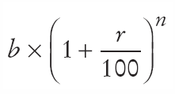

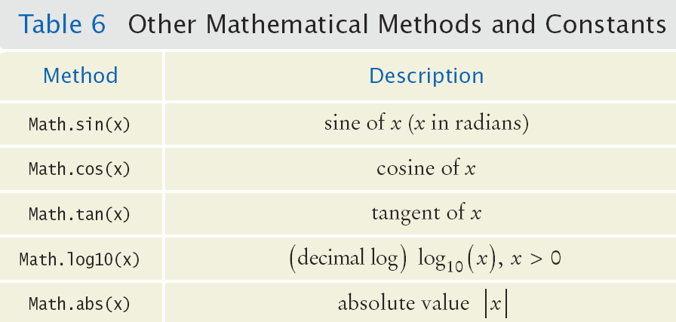
Powers and Roots
No symbols for powers and roots in Java
But we have methods of the Java Math class!
Java

Slide 35
Converting between Types
It is safe to convert a value from an integer type to a floating point type
No ‘precision’ is lost
But going the other way can be dangerous
All fractional information is lost
To force a conversion that might lose precision, ‘cast’ a variable of one type to another type as follows:
double balance = total + tax;
int dollars = (int) balance;
The fractional part is discarded (not rounded)
If you do not use the cast, the compiler will generate an error

Slide 36
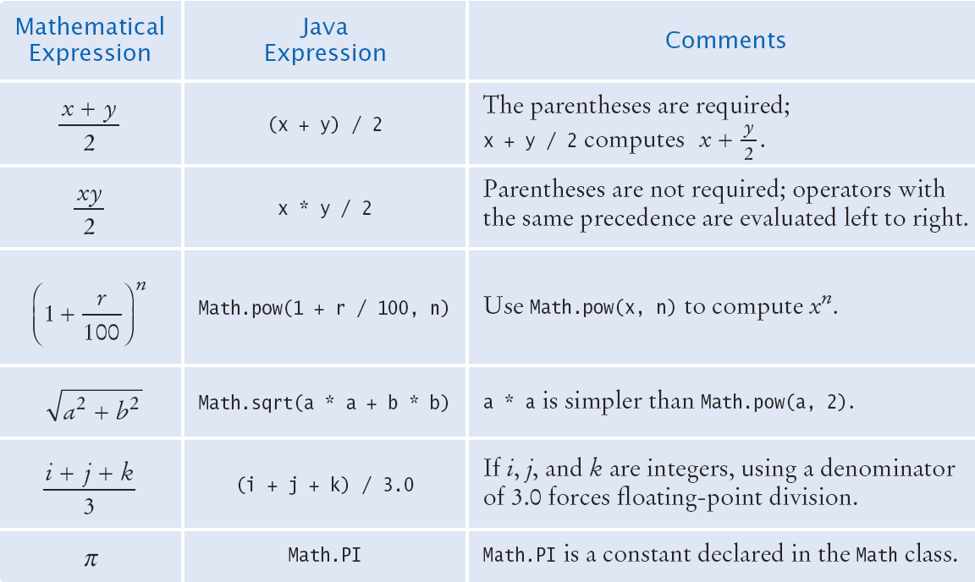
Arithmetic Expressions

Slide 37
Formatted Output
Outputting floating point values can look strange:
Price per liter: 1.21997
To control the output appearance of numeric variables, use formatted output tools such as:
System.out.printf(“%.2f”, price);
Price per liter: 1.22
System.out.printf(“%10.2f”, price);
Price per liter: 1.22
The %10.2f is called a format specifier
10 spaces
2 spaces

Slide 38
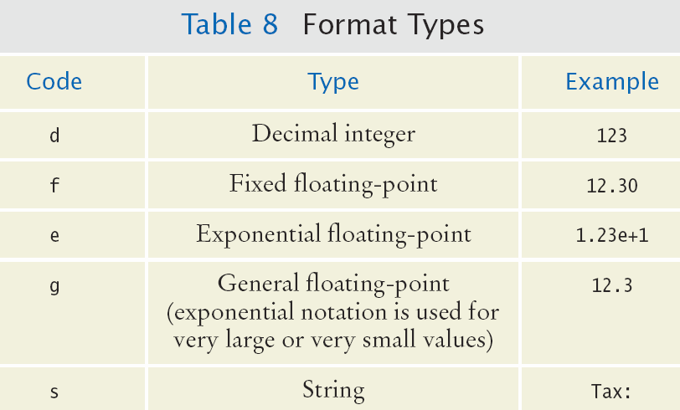
Format Types
Formatting is handy to align columns of output
You can also include text inside the quotes:
System.out.printf(“Price per liter: %10.2f”, price);

Slide 39
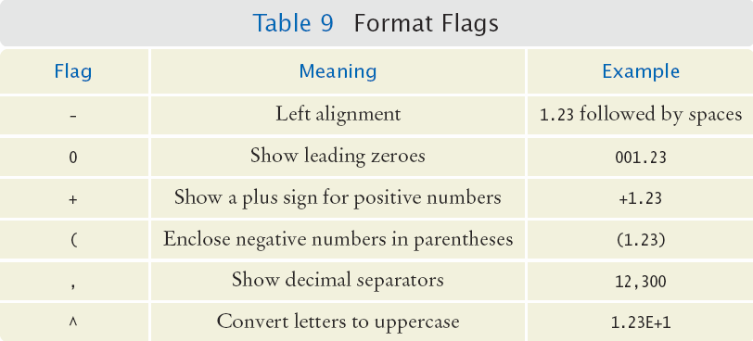
Format Flags
You can also use format flags to change the way text and numeric values are output:

Slide 40
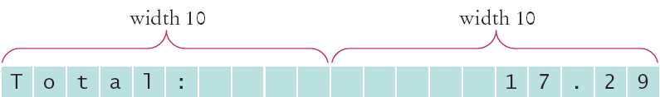
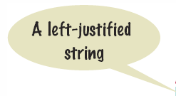

Format Flag Examples
Left Justify a String:
System.out.printf(“%-10s”, “Total:”);
Right justify a number with two decimal places
System.out.printf(“%10.2f”, price);
And you can print multiple values:
System.out.printf(“%-10s%10.2f”, “Total:”, price);

Slide 41
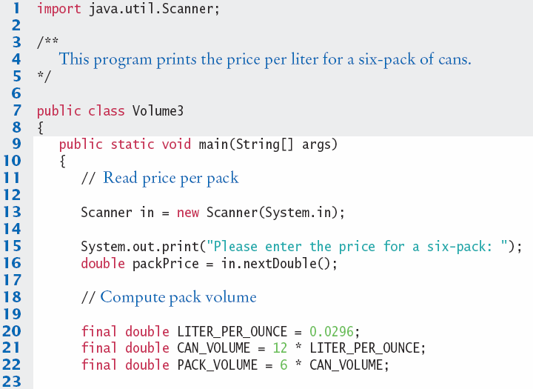
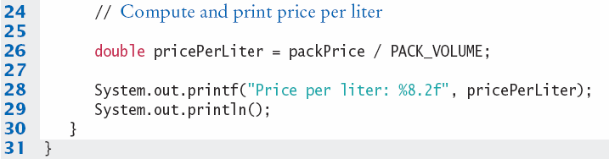
Volume3.java

Slide 42
Common Error 2.3
Unintended Integer Division
System.out.print("Please enter your last three test scores: ");
int s1 = in.nextInt();
int s2 = in.nextInt()
int s3 = in.nextInt();
double average = (s1 + s2 + s3) / 3; // Error
Why?
All of the calculation on the right happens first
Since all are ints, the compiler uses integer division
Then the result (an int) is assigned to the double
There is no fractional part of the int result, so zero (.0) is assigned to the fractional part of the double

Slide 43

Common Error 2.4
Unbalanced Parenthesis
Which is correct?
(-(b * b - 4 * a * c) / (2 * a) // 3 (, 2 )
-(b * b - (4 * a * c))) / 2 * a) // 2 (, 2 )
The count of ( and ) must match
Unfortunately, it is hard for humans to keep track
Here’s a handy trick
Count ( as +1, and ) as -1: Goal: 0
-(b * b - (4 * a * c) ) ) / 2 * a)
1 2 1 0 -1 -2

Slide 44
Common Error 2.5
Round off Errors
public class RoundoffDemo
{
public static void main(String[] args)
{
double price = 4.35;
int cents = (int) (100 * price); // Should be 435
System.out.println(cents); // Prints 434!
}
}
Why?
The float value 4.35 (in binary) is not exact
Multiplying by 100 adds to the inaccuracy
When a float is converted to an int, the entire fractional part is thrown away

Slide 45
2.6 Strings
The String Type:
Variable Literal
String name = “Harry”
Once you have a String variable, you can use methods such as:
int n = name.length(); // n will be assigned 5
A String’s length is the number of characters inside:
An empty String (length 0) is shown as “”
The maximum length is VERY long (an int)

Slide 46
String Concatenation (+)
You can ‘add’ one String onto the end of another
String fName = “Harry”
String lName = “Morgan”
String name = fname + lname; // HarryMorgan
You wanted a space in between?
String name = fname + “ ” + lname; // Harry Morgan
To concatenate a numeric variable to a String:
String a = “Agent”;
int n = 7;
String bond = a + n; // Agent7
Concatenate Strings and numerics inside println:
System.out.println("The total is " + total);

Slide 47
String Input
You can read a String from the console with:
System.out.print("Please enter your name: ");
String name = in.next();
The next method reads one word at a time
It looks for ‘white space’ delimiters
You can read an entire line from the console with:
System.out.print("Please enter your address: ");
String address = in.nextLine();
The nextLine method reads until the user hits ‘Enter’
Converting a String variable to a number
System.out.print("Please enter your age: ");
String input = in.nextLine();
int age = Integer.parseInt(input); // only digits!

Slide 48
String Escape Sequences
How would you print a double quote?
Preface the " with a \ inside the double quoted String
System.out.print("He said \"Hello\"");
OK, then how do you print a backslash?
Preface the \ with another \!
System.out.print("“C:\\Temp\\Secret.txt“);
Special characters inside Strings
Output a newline with a ‘\n’
System.out.print("*\n**\n***\n");
*
**
***

Slide 49

Strings and Characters
Strings are sequences of characters
Unicode characters to be exact
Characters have their own type: char
Characters have numeric values
See the ASCII code chart in Appendix B
For example, the letter ‘H’ has a value of 72 if it were a number
Use single quotes around a char
char initial = ‘B’;
Use double quotes around a String
String initials = “BRL”;

Slide 50
Copying a char from a String
Each char inside a String has an index number:
The first char is index zero (0)
The charAt method returns a char at a given index inside a String:
String greeting = "Harry";
char start = greeting.charAt(0);
char last = greeting.charAt(4);
0 | 1 | 2 | 3 | 4 | 5 | 6 | 7 | 8 | 9
c | h | a | r | s |  | h | e | r | e
0 | 1 | 2 | 3 | 4
H | a | r | r | y

Slide 51
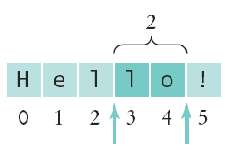
Copying part of a String
A substring is a portion of a String
The substring method returns a portion of a String at a given index for a number of chars, starting at an index:
String greeting = "Hello!";
String sub = greeting.substring(0, 2);
String sub2 = greeting.substring(3, 5);
0 | 1 | 2 | 3 | 4 | 5
H | e | l | l | o | !
0 | 1
H | e

Slide 52
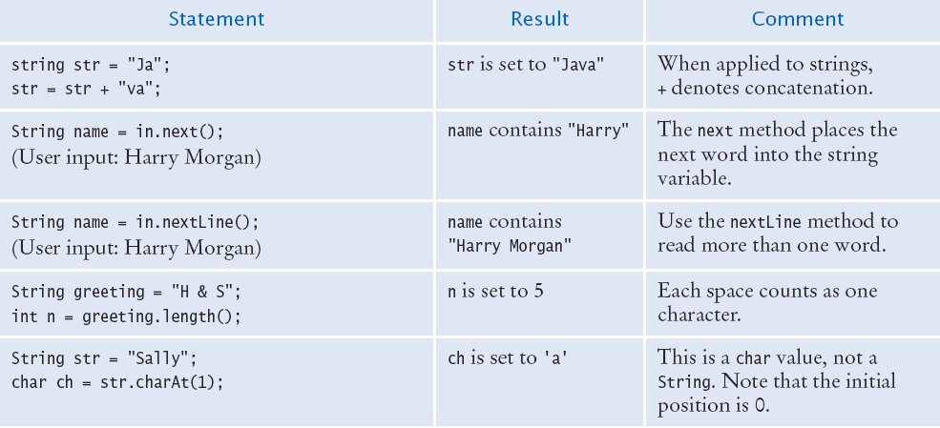
Table 10: String Operations (1)

Slide 53
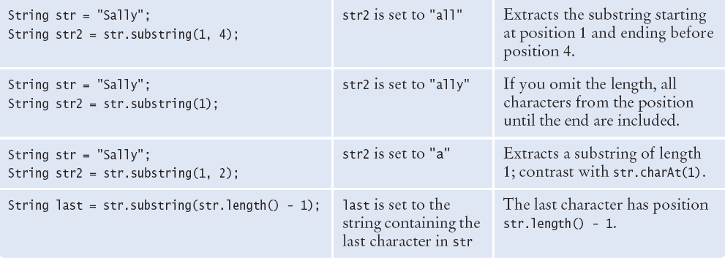
Table 10: String Operations (2)

Slide 54
Summary: Variables
A variable is a storage location with a name.
When declaring a variable, you usually specify an initial value.
When declaring a variable, you also specify the type of its values.
Use the int type for numbers that cannot have a fractional part.
Use the double type for floating-point numbers.
Use comments to add explanations for humans who read your code. The compiler ignores comments.
You cannot change the value of a variable that is declared as final.

Slide 55
Summary: Operators
An assignment statement stores a new value in a variable, replacing the previously stored value.
The assignment operator = does not denote mathematical equality.
The ++ operator adds 1 to a variable; the -- operator subtracts 1.
Java classes are grouped into packages. Use the import statement to use classes from packages.
Use the Scanner class to read keyboard input in a console window.
The API (Application Programming Interface) documentation lists the classes and methods of the Java library.

Slide 56
Summary: Math and casting
If both division arguments (/) are integers, the remainder is discarded.
The modulo (%) operator computes the remainder of an integer division.
The Java library declares many mathematical functions such as Math.sqrt (square root) and Math.pow (raising to a power).
You use a cast (typeName) to convert a value to a different type.
Use the printf method to specify how values should be formatted.

Slide 57
Summary: Strings
Strings are sequences of characters.
The length method yields the number of characters in a String.
Use the + operator to concatenate Strings; that is, to put them together to yield a longer String.
Use the next or nextLine method of the Scanner class to read a String.
Whenever one of the arguments of the + operator is a String, the other argument is converted to a String.
If a String contains the digits of a number, you use the Integer.parseInt or Double.parseDouble method to obtain the number value.
String index numbers are counted starting with 0.

